Slide 1
RANDC traffic lights with Appinventor and Arduino
Appinventor
1.1. Designer:
In designer section you can design the look of application.
You can add pictures, buttons, arrangements, labels, Bluetooth clients, sensors, clock,…
We want to design application, with which we will control and change traffic lights.
We need to add:
4 buttons
2 labels
4 pictures (folder RANDC resources on your computer)
3 horizontal arrangements

Slide 2
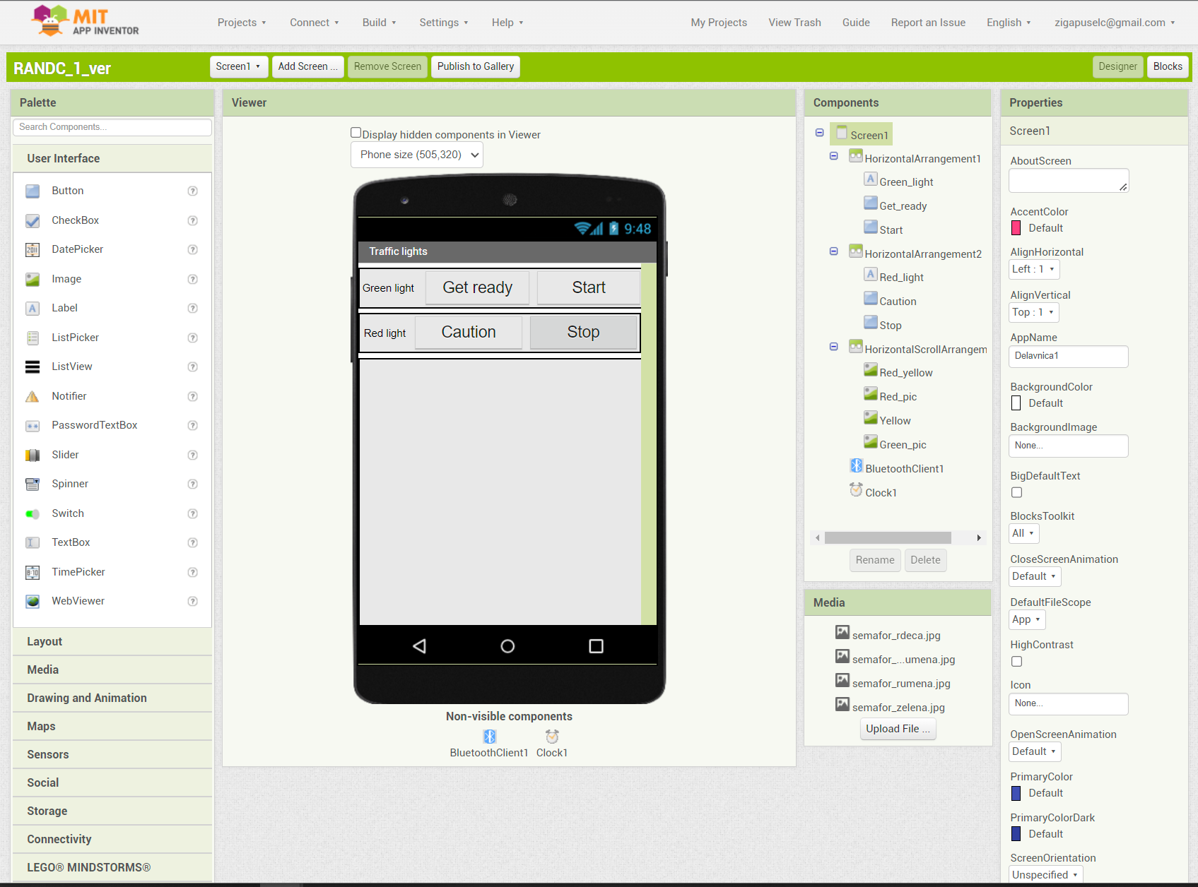
On picture below you can see an example how to arrange all the components (pictures are hidden).

Slide 3
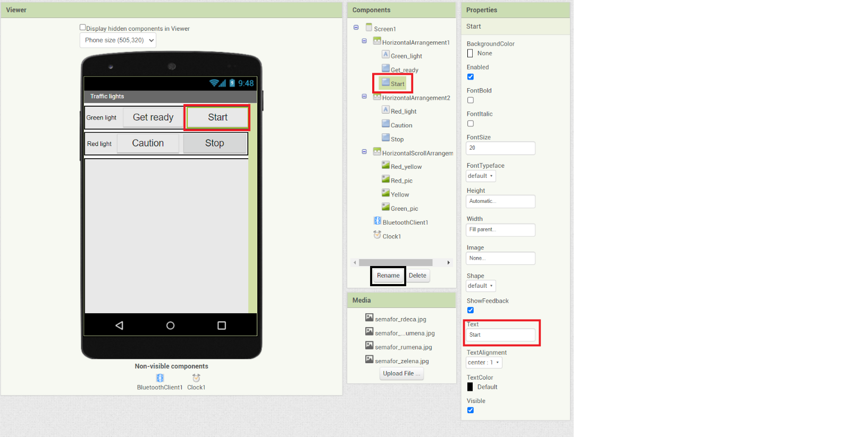
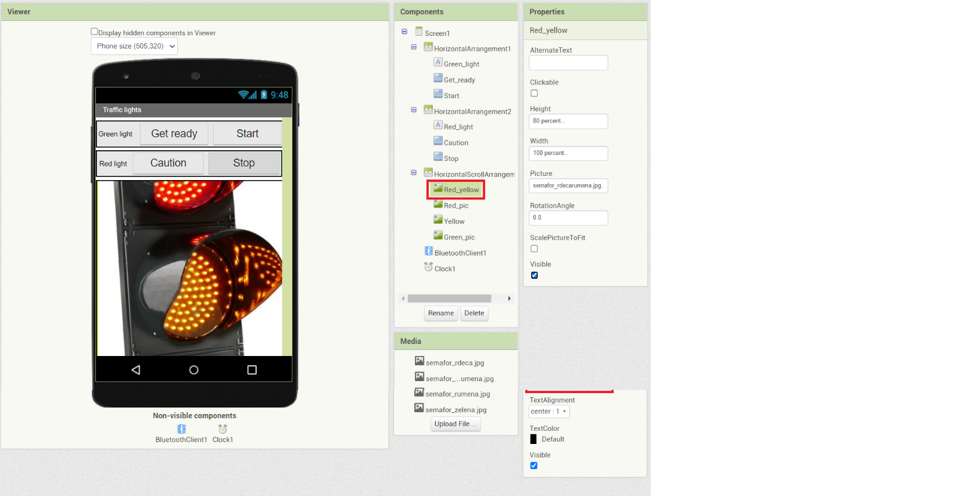
For easier reading and later programming, we can rename buttons and what is written on them. Same goes for labels and pictures.

Slide 4
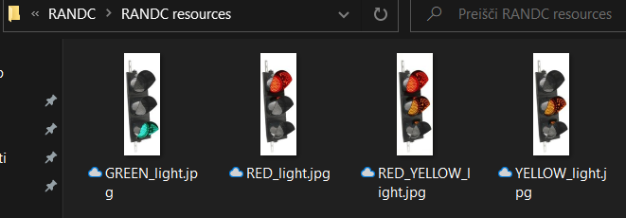
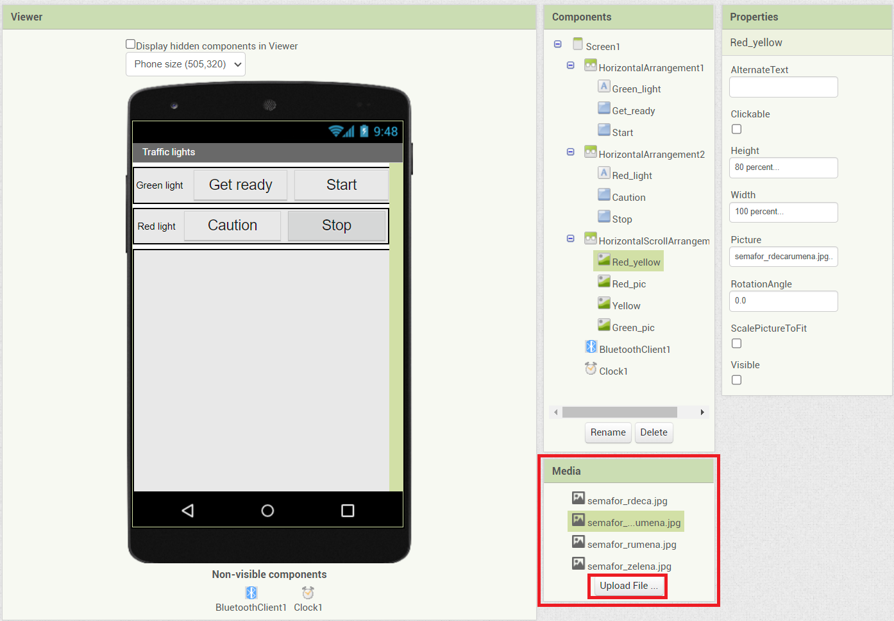
To work with pictures we want, we need to import them into our project. You cant find pictures of traffic lights in all combinations on your computers. Pictures are in folder »RANDC resources«. There are 4 pictures, which you will need for this project.

Slide 5
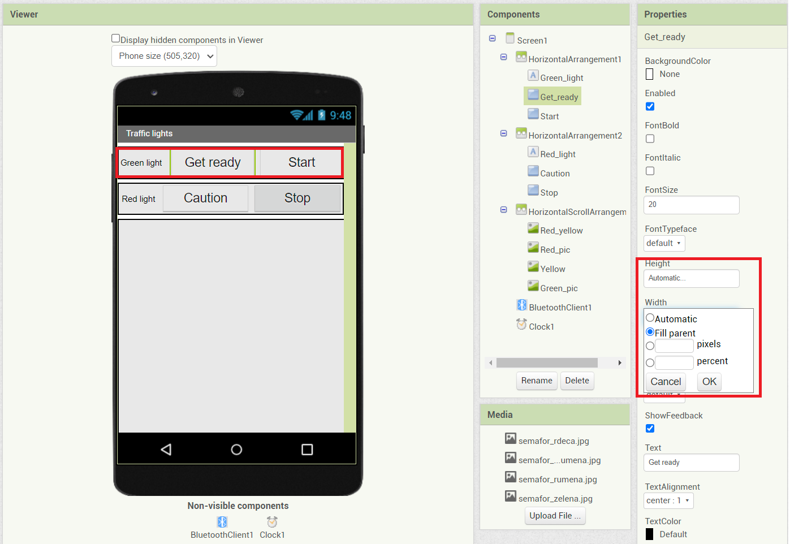
To get a better looking button layout we can use function »Fill parent« in height and width section. Same for pictures, labels and horizontal arrangements.

Slide 6
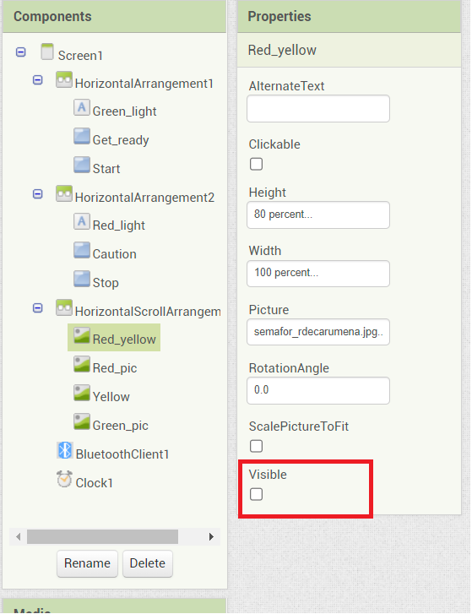
We can also hide pictures, so they will only show up, when we press specific button.

Slide 7
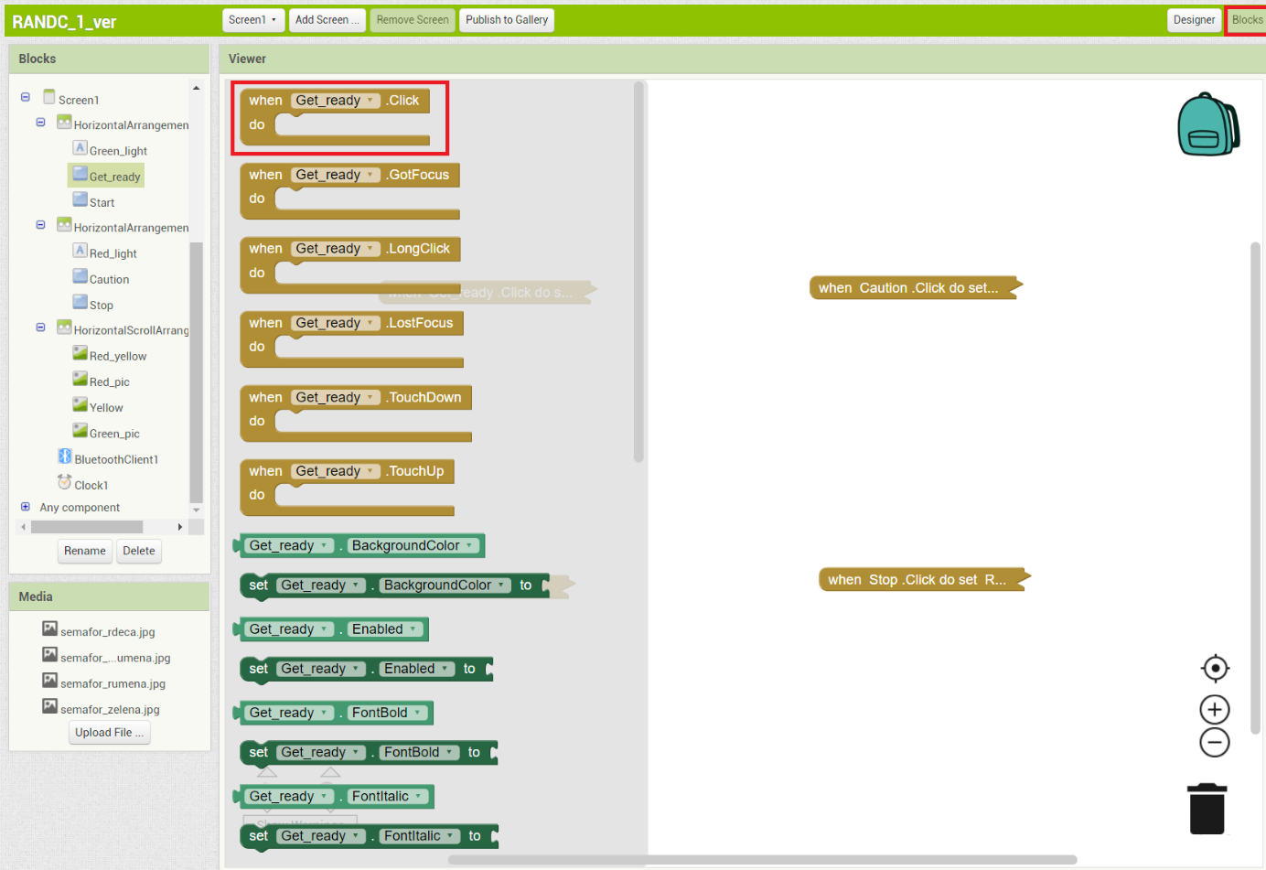
1.2. Blocks:

Slide 8
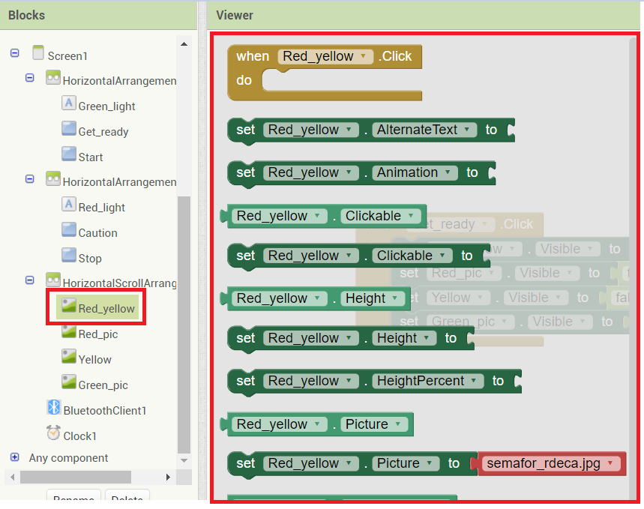
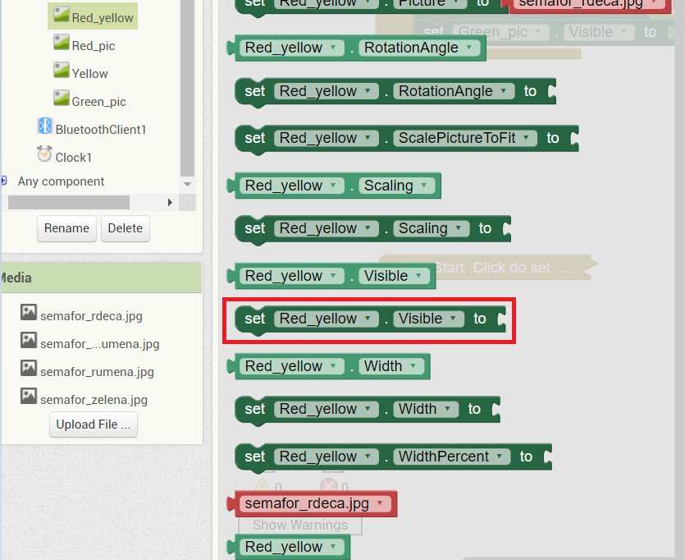

Slide 9
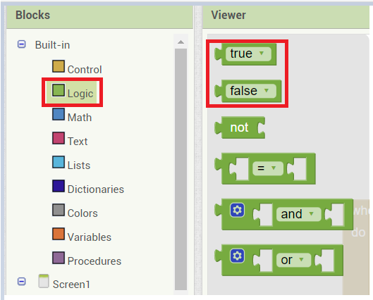
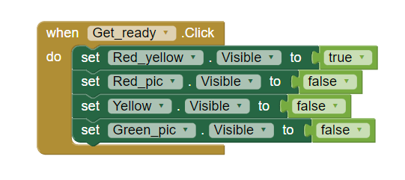

Slide 10
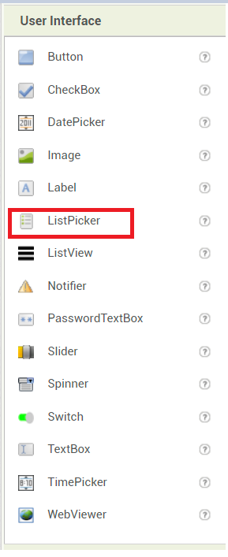
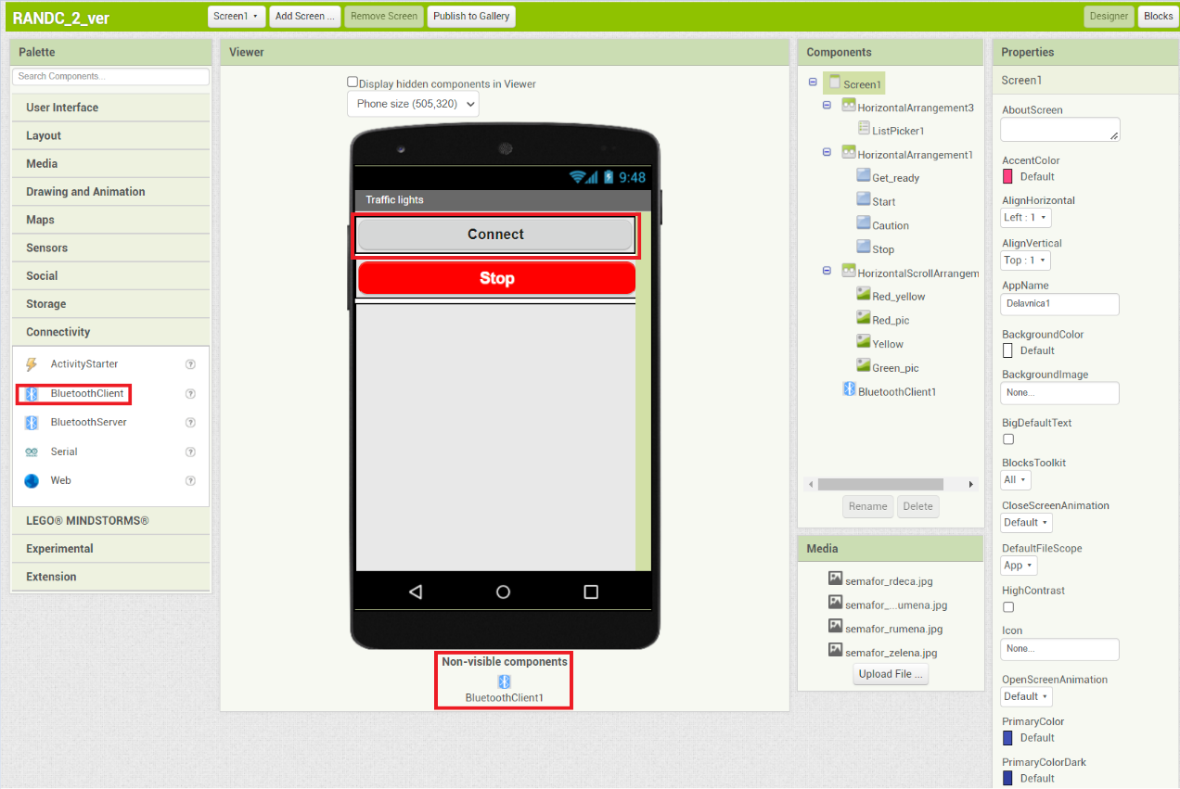
2. Arduino

Slide 11
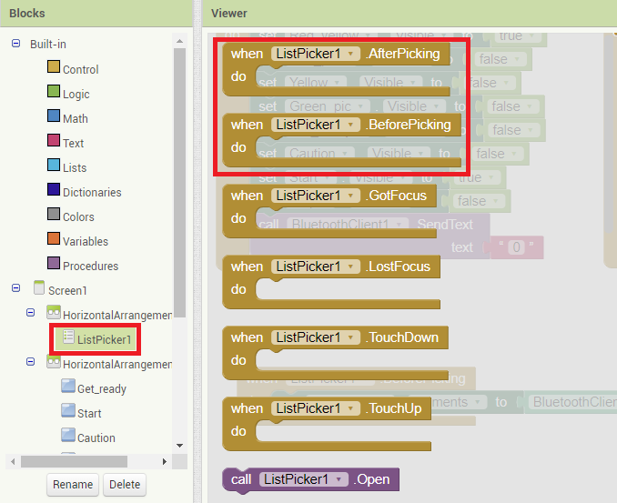
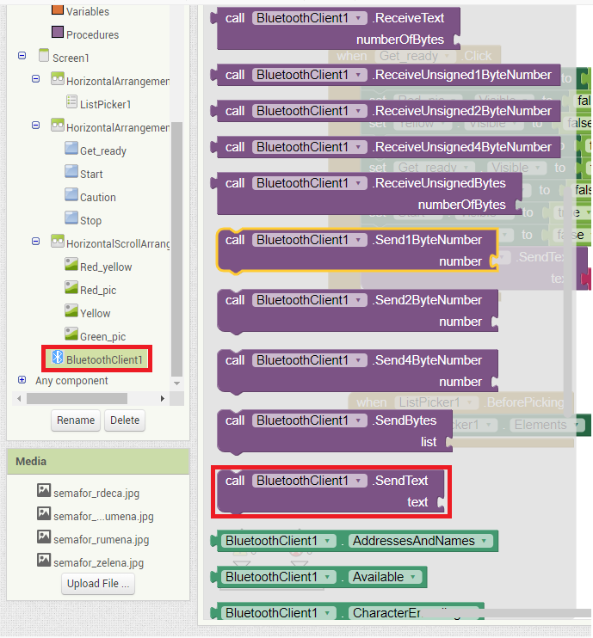

Slide 12
